Slide 1
American Imperialism in the 19th–20th Centuries
The American Pageant,
Chapter 27

Slide 2
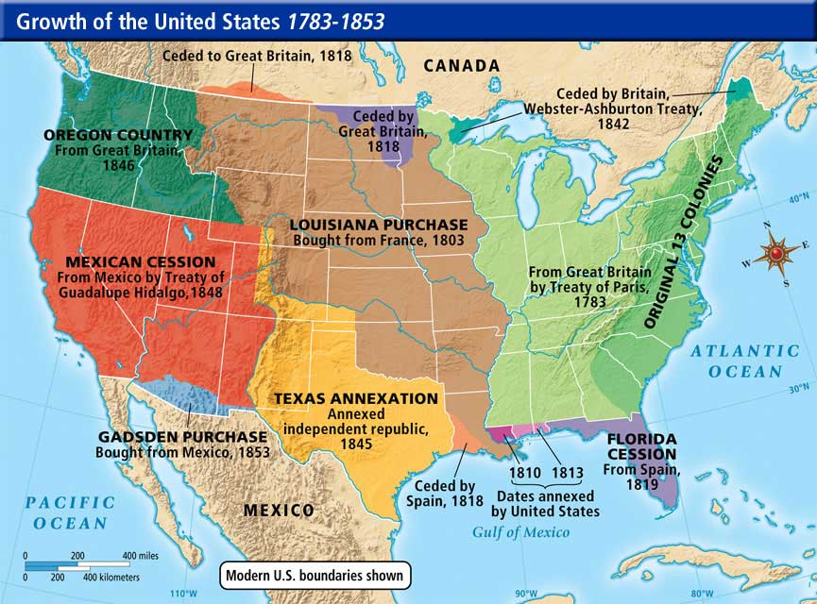
Key to Remember!
Expansion is part of our story
Louisiana Territory
Texas, Mexico
Florida, Spain
Overpopulation
California, Gold Rush
1893— “The frontier is closed”
1890s—US seeks to move beyond its borders
Must know date—1898**

Slide 3
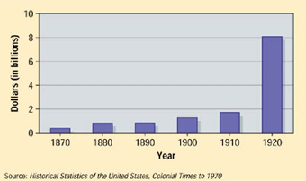
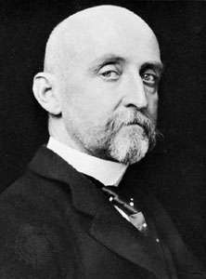
Reasons for Imperialism
Imperialism**
Why?
Money / resources
America’s sweet tooth
More markets—more trade
Compete with other nations—build up
Military reasons—a force to be reckoned with
Navy**
Alfred T. Mahan, The Influence of Sea Power**
Panama Canal
The “white man’s burden”
Anglos are superior; civilize the outside world

Slide 4
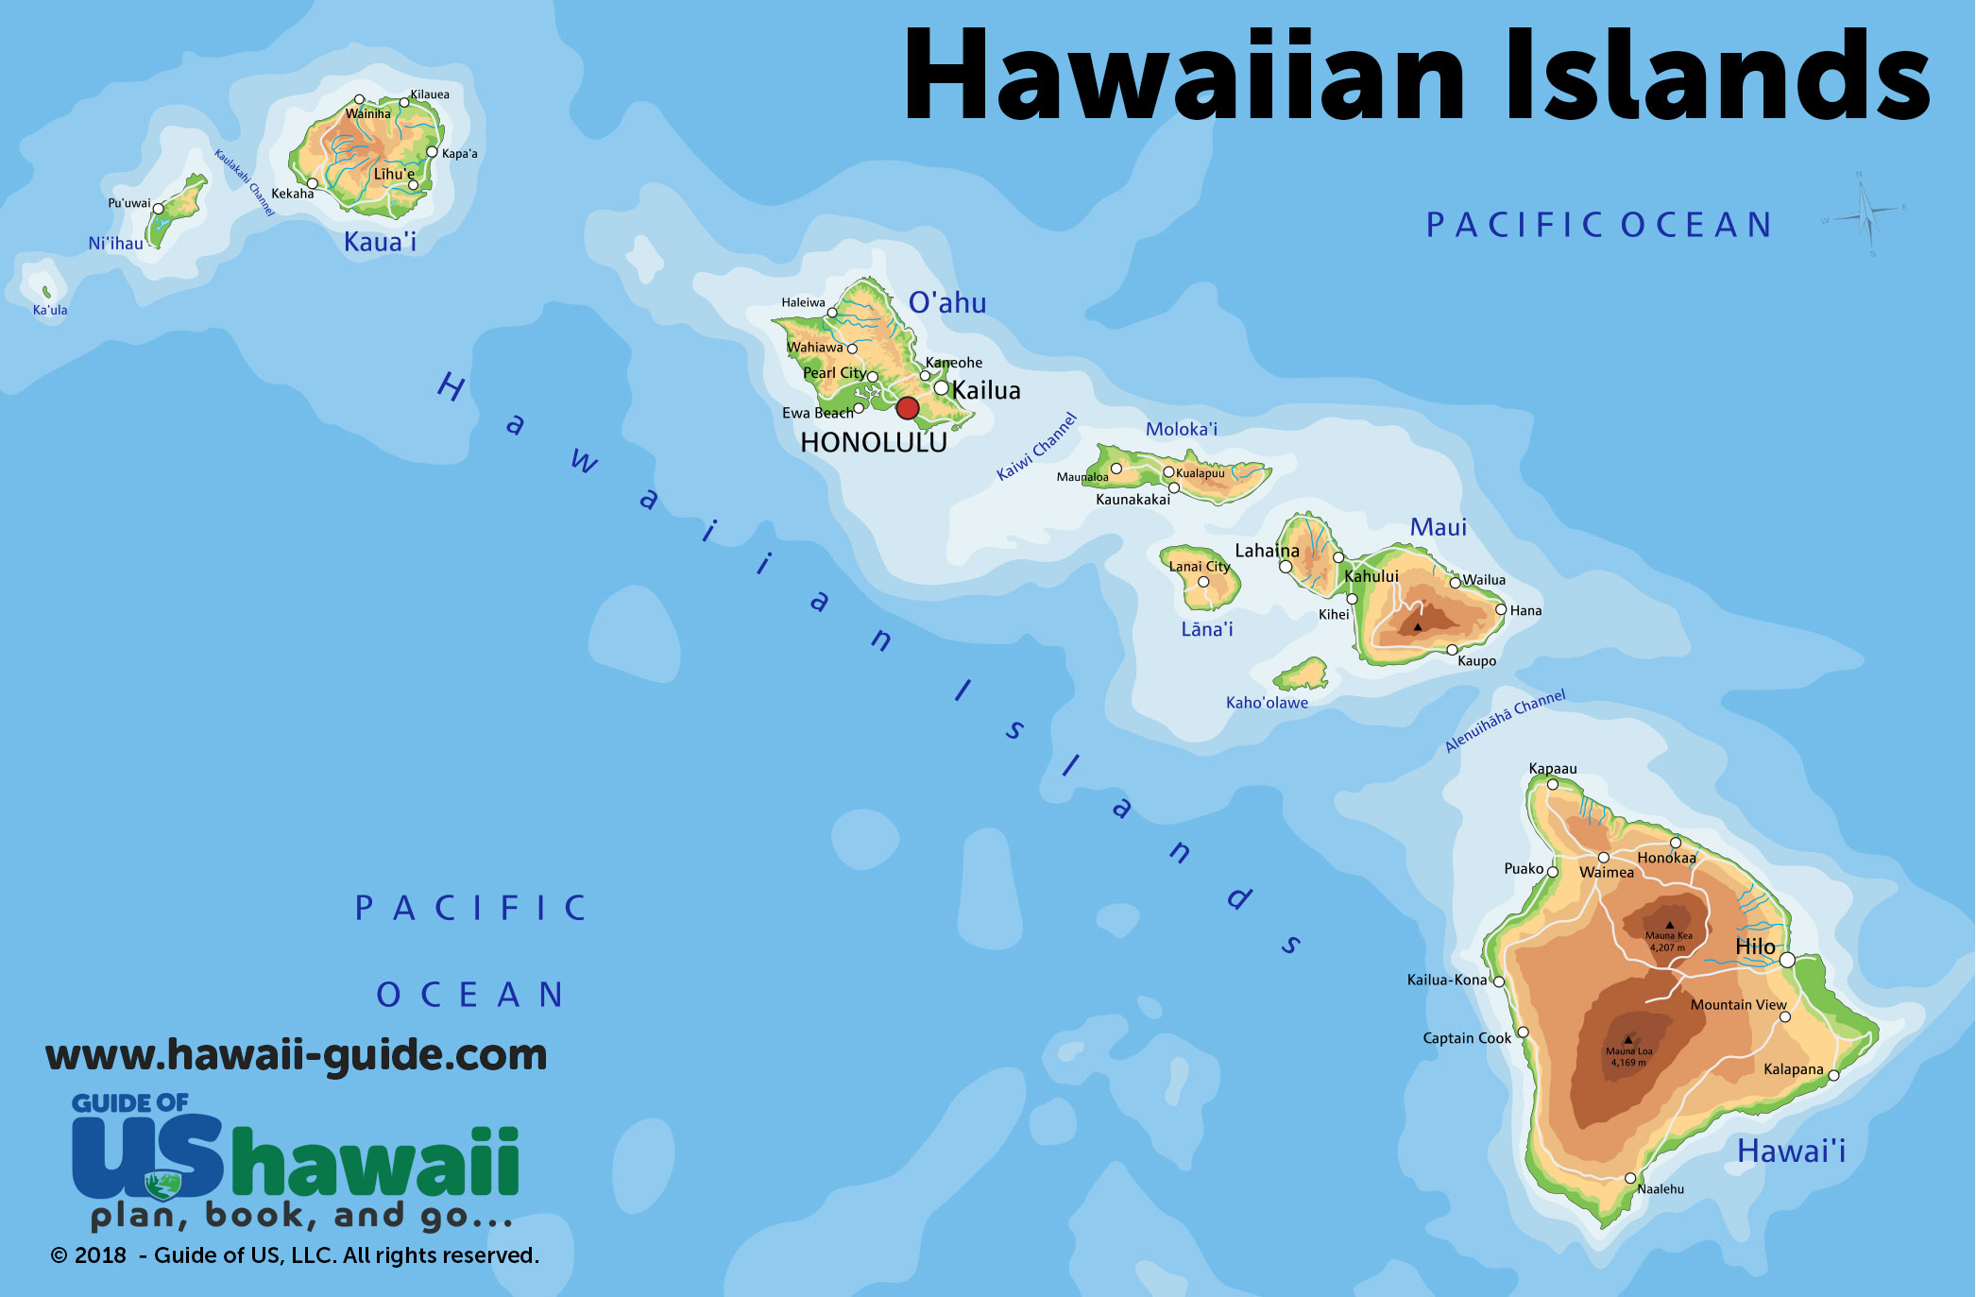
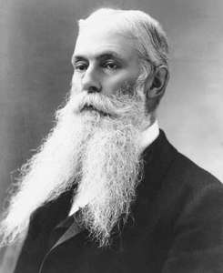
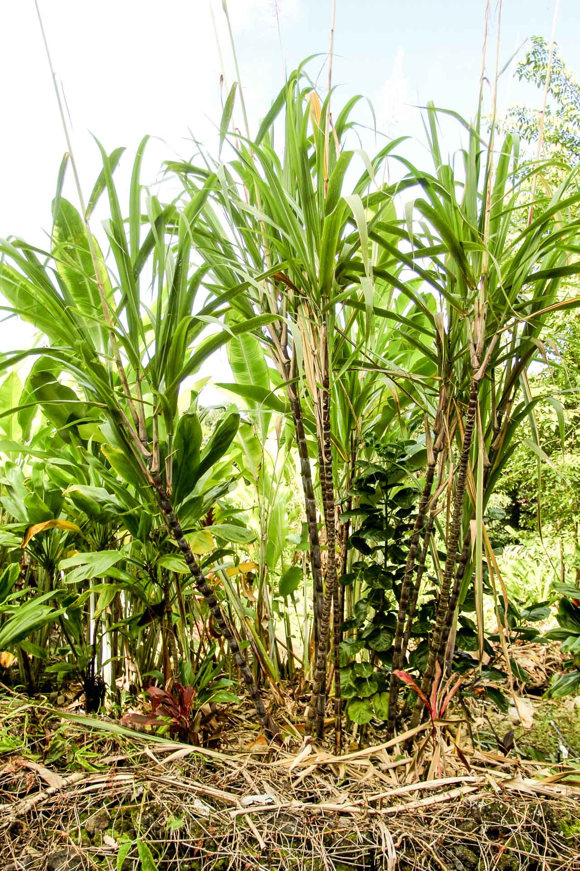
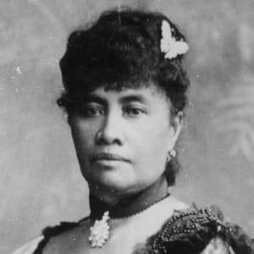
HAWAII—1820s
US wants Hawaii**
Sanford B. Dole**
Annexed in 1898—McKinley**
Why?
Military**
1887—Pearl Harbor
Resources**
How?
Missionaries**
Hawaii is an independent kingdom
Don’t want to be part of US
Queen Liliuokalani
US-led coup

Slide 5
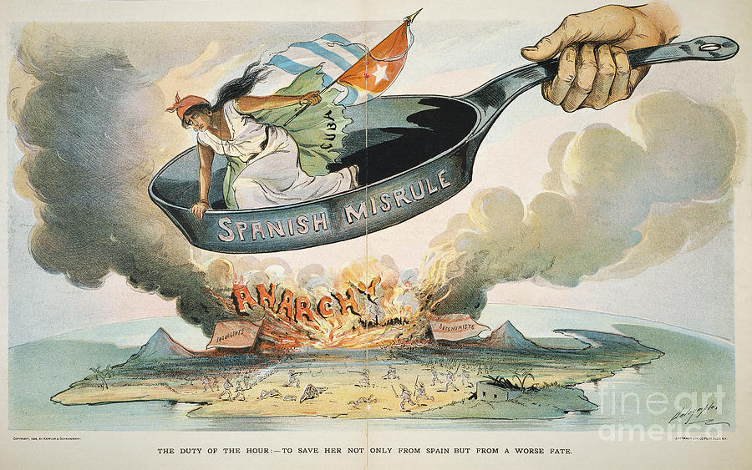
Spanish-American War
Spain controls Cuba in the late 19th century
Spanish rule is harsh
General “Butcher” Weyler
Cuba wants independence
Revolts
US cares!
Isolationism v. Expansionism
Is it our problem?
LAD²
Dollar Diplomacy
Taft

Slide 6
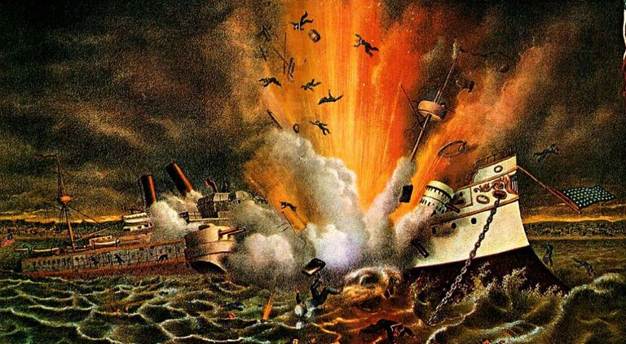
Why the U.S. Cared about Cuba
Money, investment
Sympathy for Cubans
Yellow Journalism (Hearst, Pulitzer, etc.)**
De Lome Letter
Spanish official disrespects US, our President
Big Event—USS Maine, 1898**

Slide 7
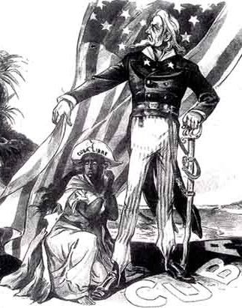
Response to USS Maine
Impact of Yellow Journalism
US declares war against Spain (McKinley)
Prior to war—Teller Amendment
Defend American honor; don’t take over Cuba

Slide 8
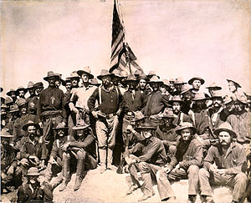
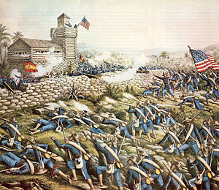
Spanish-American War**
John Hay—Secretary of War
“A splendid war”
Lasts less than half a year
Manila Bay
George Dewey—crushes Spanish fleet
Theodore Roosevelt**
Leader of the Rough Riders
San Juan Hill
War begins—and ends—in 1898*****
Treaty of Paris

Slide 9
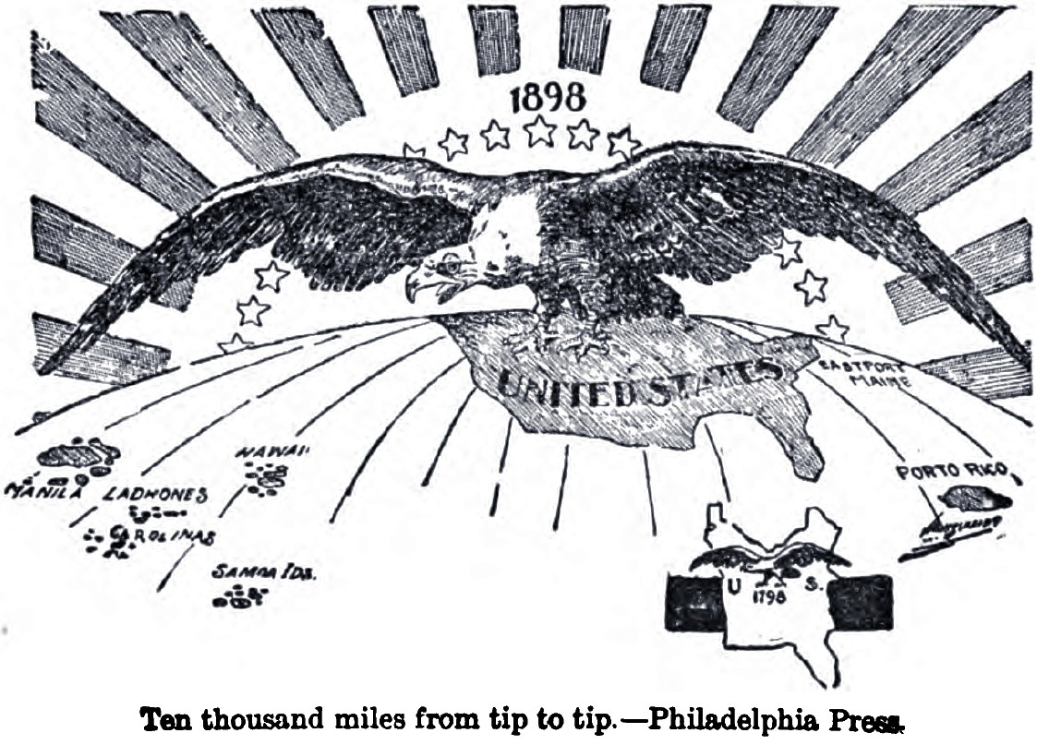
Lasting Impact of Span-Am War
US expands its borders to become a GLOBAL-, OVERSEAS-, WORLD- POWER
Established ourselves worldwide
Defeated a major European power (again)
What to do with new territories?
A lot of debate about the treaty itself—need 2/3 majority in congress to ratify
Anti-Imperialist League opposes annexation of Philippines
Self Determination?
Still—treaty is ratified
US acquires territories of—
Guam, PUERTO RICO, Philippines**
Spain paid for territories, but US possess them

Slide 10
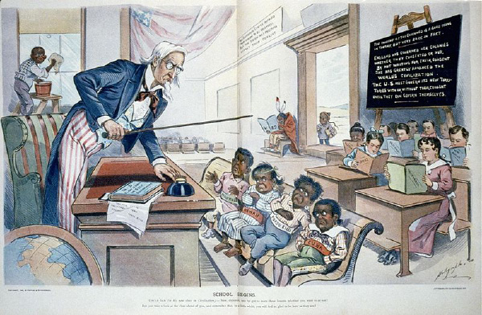

Slide 11
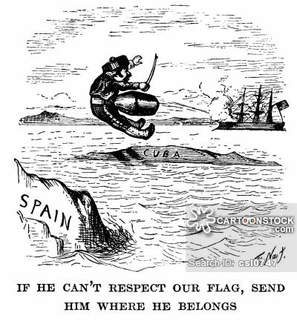
Cuba
US leaves Cuba—1902. Sort of.
Teller Amendment replaced by Platt Amendment
US intervenes in Cuba to “restore order” when necessary
Cuba cannot sign a treaty with another country
US maintains presence in Gitmo**
Resentment by Cubans
Why not just leave?
Similar in kind…

Slide 12
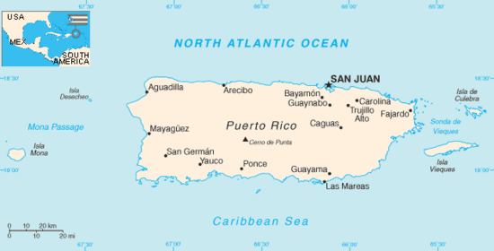
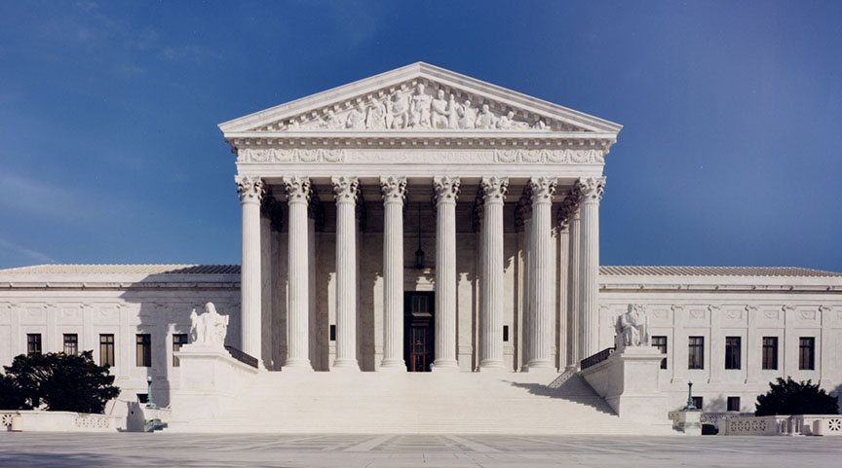
Puerto Rico
Foraker Act—1900
Grants some popular government
Limits self-rule
Grants citizenship in 1917
Status?
Do protections of Constitution apply in territories?
Insular Cases
Not necessarily

Slide 13
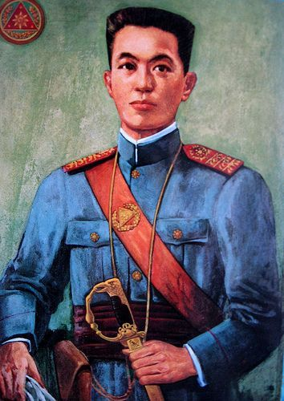
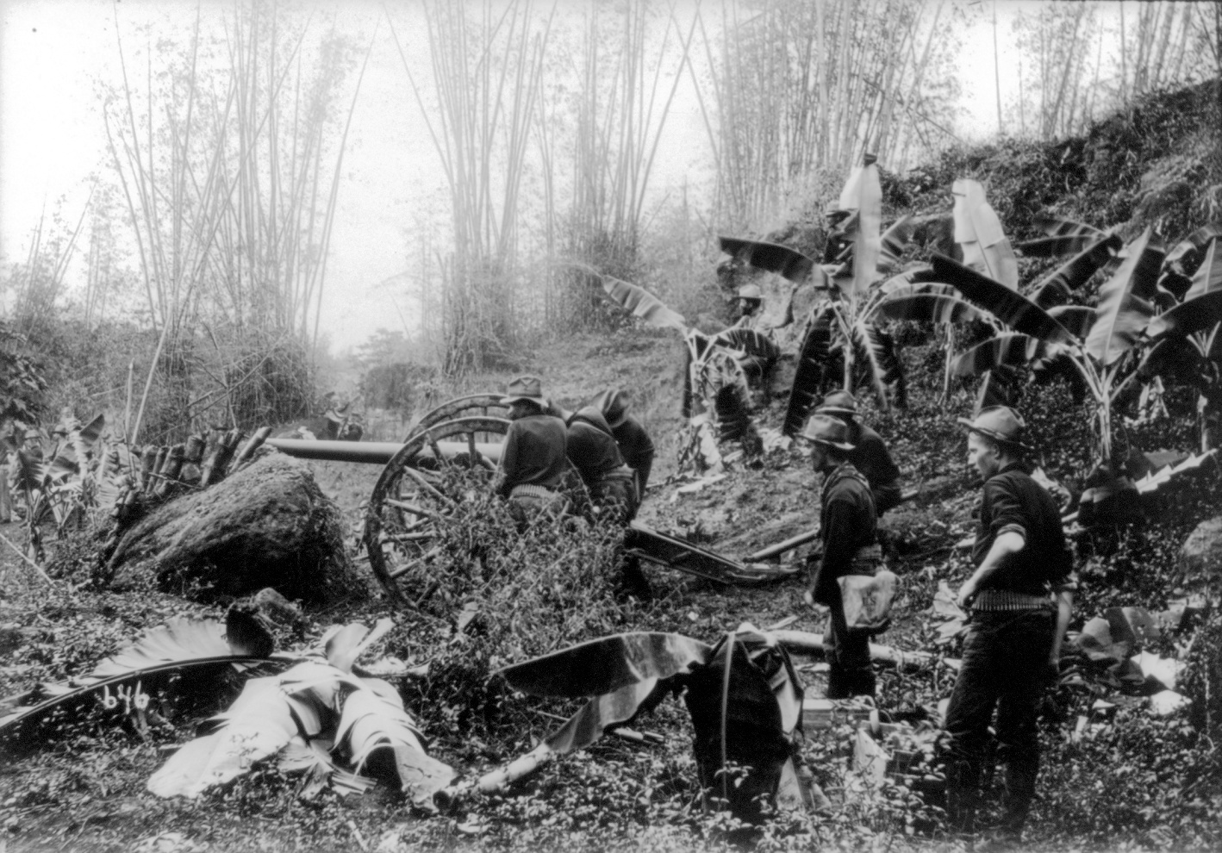
The Philippines
Philippines also occupied by Spain prior to 1898
Emilio Aguinaldo—leads movement against Spanish
Fights with US
Expected independence after the war—to no avail
Guerilla war breaks out between US and Philippines (three years)
Formal independence not granted until 1946
After World War II

Slide 14
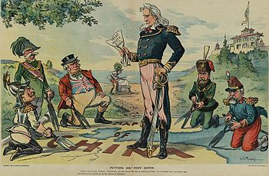
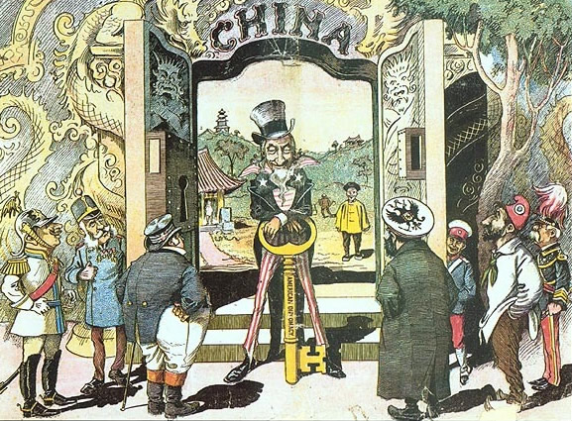
Remember Hawaii?
US wants control of Hawaii—why?
PART of the reason—money, resources, military.
The other part—China (OCD)**
Access to Hawaii = military base to connect to Pacific
Access to Pacific = Proximity to Philippines = Proximity to China
It’s all about the money!
Problem—spheres of influence
Not on my turf!
John Hay—Open Door Policy**
Boxer Rebellion (unsuccessful)

Slide 15
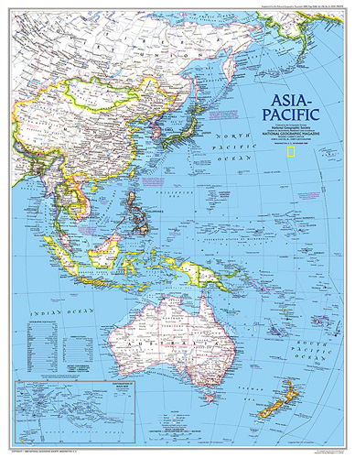

Slide 16
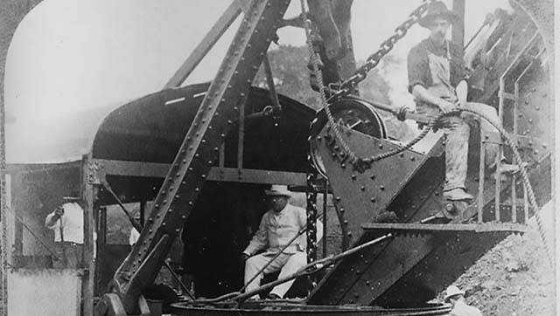
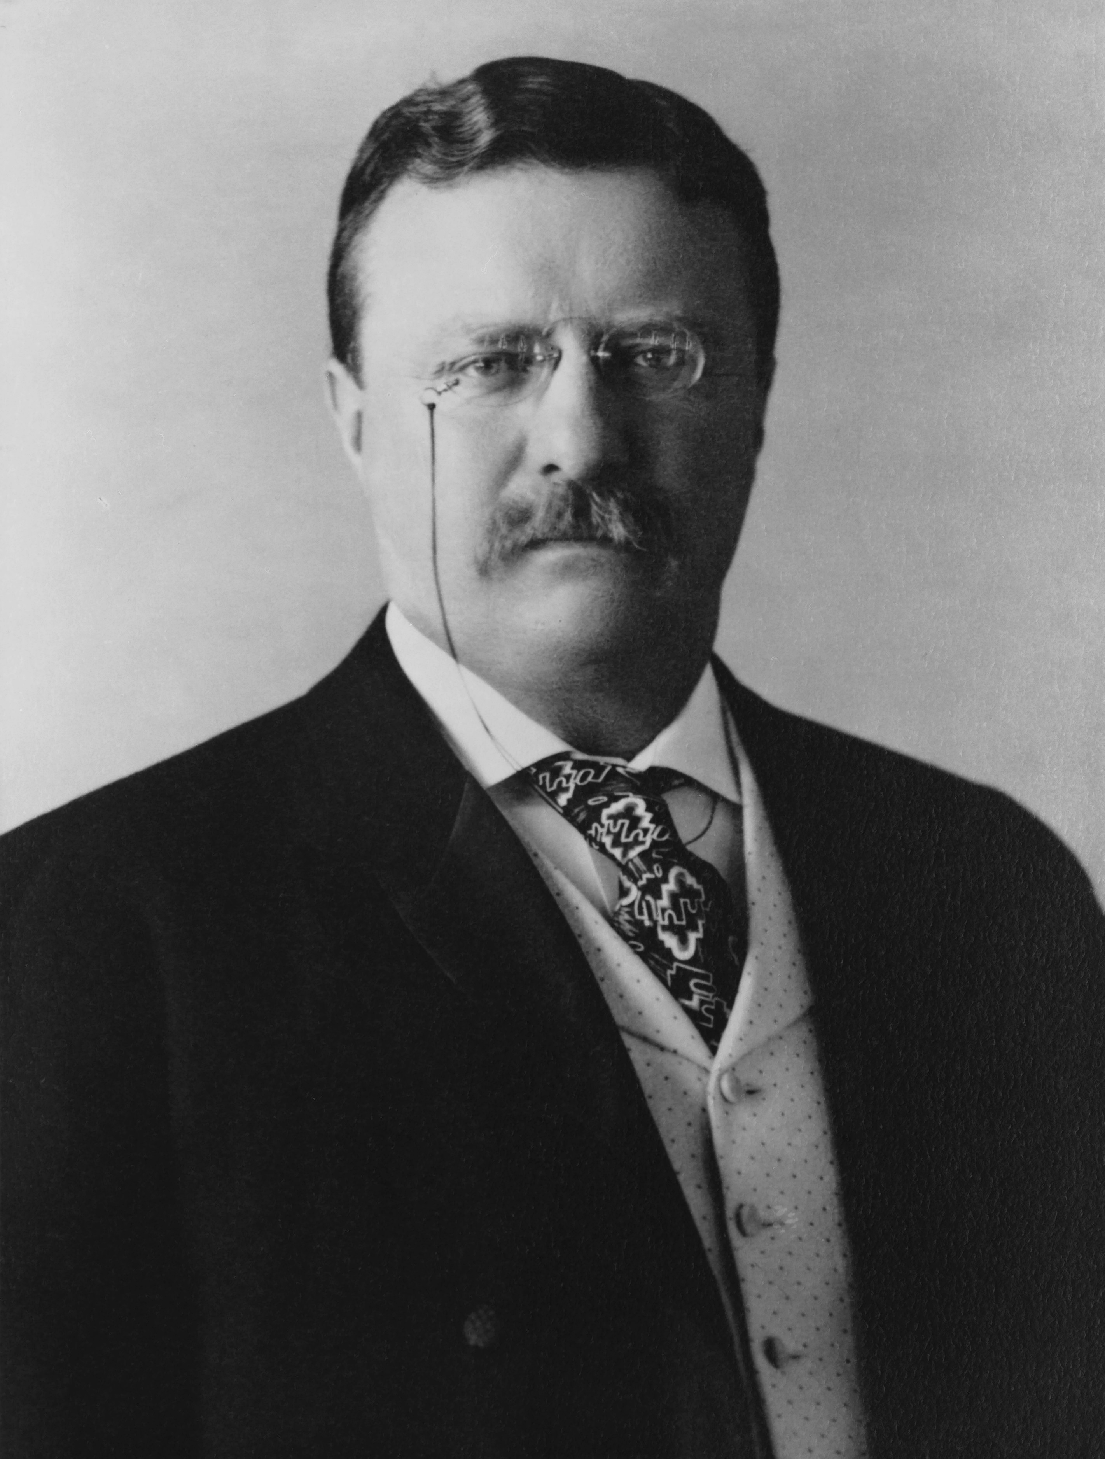
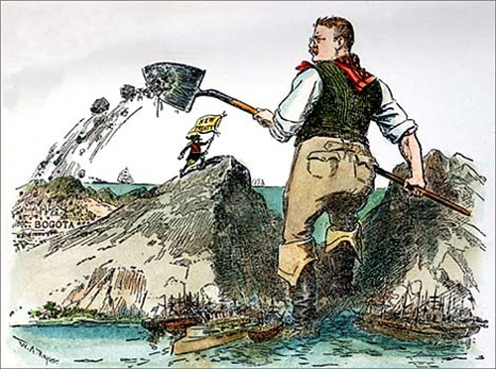
Theodore Roosevelt
McKinley still president-reelected in 1900
Teddy is his running mate
Nobody expects him to ever be President
Ran on popularity
McKinley is assassinated in 1901
TR new president**
Dramatically increases power of presidency**
Similar in kind…
Speak softly, carry a big stick**

Slide 17
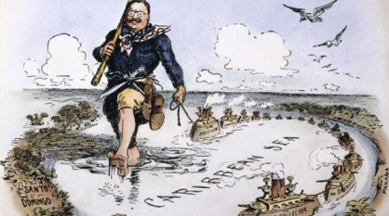
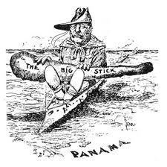
TR The Expansionist
Panama Canal**
Money, time, military
France attempts first canal—fails!
TR—wants treaty with Colombia
Access to build a canal in Panama—rejected
Speak softly, carry a big stick
US backed movement to aid Panama against Columbian control
Hay-Bunanu-Varilla Treaty
US builds a canal—controversial!
Completed in 1914

Slide 18
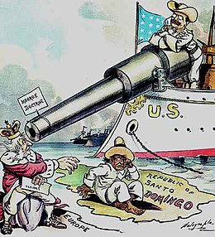
Roosevelt Corollary, Monroe Doctrine
Monroe Doctrine—warned Europe to “stay out”
Latin-American countries in debt to England and Germany
Europe starts to intervene
TR responds with a corollary
US will intervene in Latin America
US will police the area if necessary
US more involved in the region
US isn’t looking out for Latin America—it’s looking out for itself
Strains relations between LA and US

Slide 19
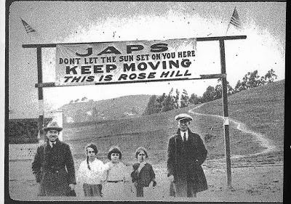
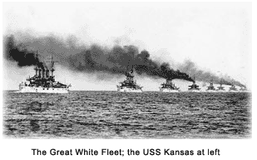
Roosevelt in Asia
Russo-Japanese War in 1905
TR negotiates peace between the two (Nobel-Prize winner)
Japan kicks tail—worries TR
Gentlemen’s Agreement—1908
Japan offended by anti-immigrant (anti-Asian) US-laws
Segregation in schools, etc.
In agreement—
Japan agrees to restrict emigration of workers to the US
TR pressures CA to repeal segregationist laws
Great White Fleet
TR sends our naval fleet across to world
“Don’t mess with us”

Slide 20
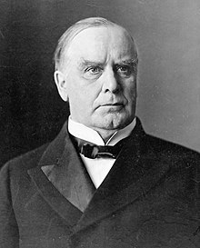
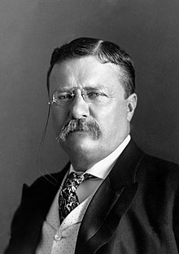
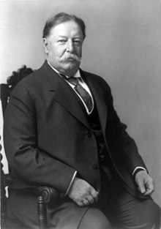
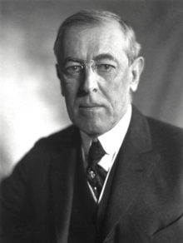
Presidents of the Time
McKinley (R) (1897-1901)
T. Roosevelt (R) (1901-1909)**
Much more detail to discuss later!
“The bride at every wedding, the corpse at every funeral”
Taft (R) (1909-1913)
Wilson (D) (1913-1921)**
All POTUS during this time increase American presence on the world stage
Span-AM
Panama Canal
Big Stick
Hawaii
Open Door Policy
Dollar
Diplomacy
WWI
League of Nations

